Slide 1
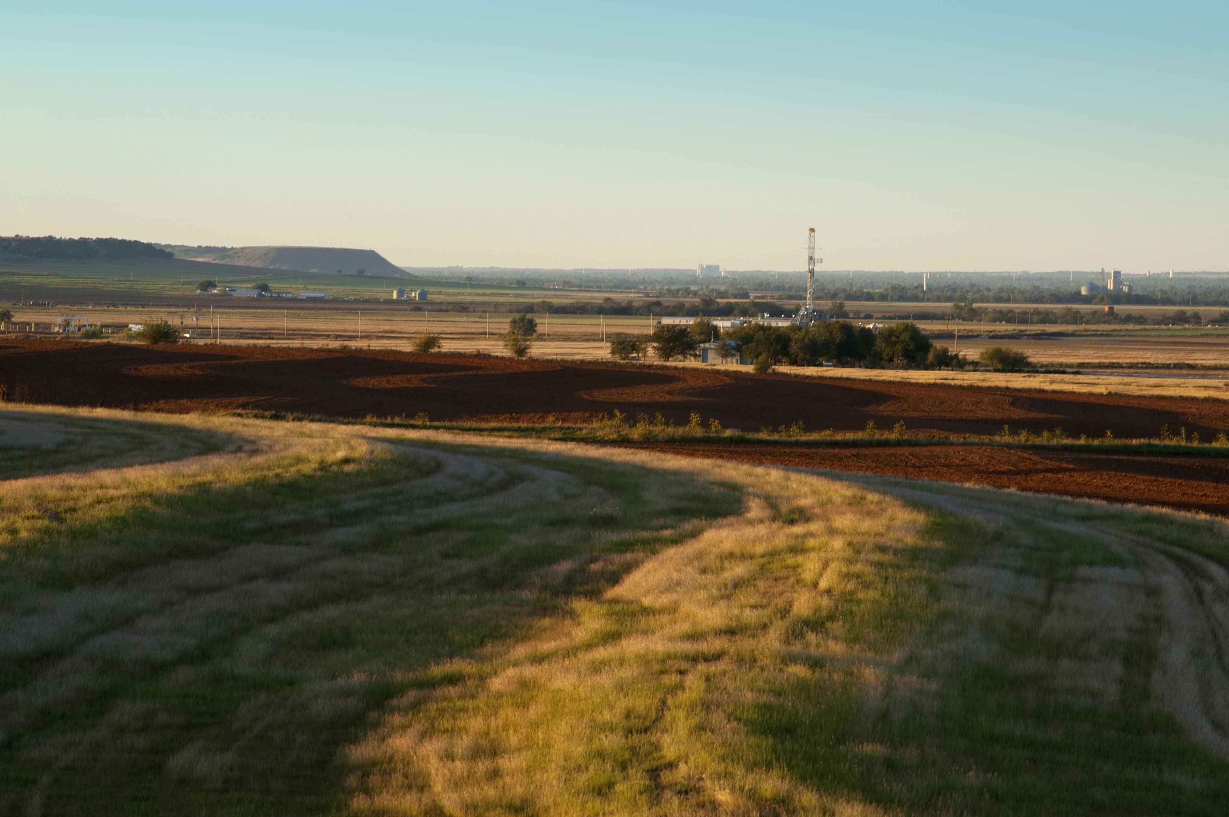
Completions Analysis & Alerting
The Chaos Monkeys

Slide 2
Chaos Monkeys
About us
Hackers not programmers
Digital security (Sean and Paul PC)
Data Analytics (Paul B)
Cloud Automation (Tyler)
Database (Michael)
Solution shows:
Focus on working prototype
Various components cobbled together
Python, Azure, Nifi, SQL are our hammers

Slide 3
Solution
Problem #2: Completions
Chart data from PI
Monitor:
producing wells in the geographic adjacency (5 km) of the fracturing job for anomalous rise in pressure
Oil tanks for abnormal rise in volume
Alert via mobile pop up
Present the data via PowerBI on mobile / desktop (web) on a streaming basis

Slide 4
The Tech, The Data, The Shiny Stuff
In a not-so-shiny chart

Slide 5
From
{'2017-11-01T05:35:08': {'surface-sand-conc': 0.55}, '2017-11-01T05:35:09': {'surface-sand-conc': 0.54}, '2017-11-01T05:35:10': {'surface-sand-conc': 0.53}, '2017-11-01T05:35:11': {'surface-sand-conc': 0.53}, '2017-11-01T05:35:12': {'surface-sand-conc': 0.52}, '2017-11-01T05:35:13': {'surface-sand-conc': 0.51}, '2017-11-01T05:35:14': {'surface-sand-conc': 0.5}, '2017-11-01T05:35:15': {'surface-sand-conc': 0.49}, '2017-11-01T05:35:16': {'surface-sand-conc': 0.49}, '2017-11-01T05:35:17': {'surface-sand-conc': 0.48}, '2017-11-01T05:35:18': {'surface-sand-conc': 0.47}, '2017-11-01T05:35:24': {'surface-sand-conc': 0.47}, '2017-11-01T05:35:25': {'surface-sand-conc': 0.46}, '2017-11-01T05:35:26': {'surface-sand-conc': 0.47}, '2017-11-01T05:35:27': {'surface-sand-conc': 0.47}, '2017-11-01T05:35:28': {'surface-sand-conc': 0.46}, '2017-11-01T05:35:29': {'surface-sand-conc': 0.47}, '2017-11-01T05:35:30': {'surface-sand-conc': 0.47}, '2017-11-01T05:35:31': {'surface-sand-conc': 0.46}, '2017-11-01T05:35:32': {'surface-sand-conc': 0.46}, '2017-11-01T05:35:33': {'surface-sand-conc': 0.45}, '2017-11-01T05:35:34': {'surface-sand-conc': 0.45}, '2017-11-01T05:35:35': {'surface-sand-conc': 0.44}, '2017-11-01T05:35:36': {'surface-sand-conc': 0.44}, '2017-11-01T05:35:37': {'surface-sand-conc': 0.43}, '2017-11-01T05:35:38': {'surface-sand-conc': 0.43}, '2017-11-01T05:35:39': {'surface-sand-conc': 0.44}, '2017-11-01T05:35:43': {'surface-sand-conc': 0.44}, '2017-11-01T05:35:44': {'surface-sand-conc': 0.45}, '2017-11-01T05:35:52': {'surface-sand-conc': 0.45}, '2017-11-01T05:35:53': {'surface-sand-conc': 0.44}, '2017-11-01T05:35:54': {'surface-sand-conc': 0.43}, '2017-11-01T05:35:55': {'surface-sand-conc': 0.43}, '2017-11-01T05:35:56': {'surface-sand-conc': 0.42}, '2017-11-01T05:35:57': {'surface-sand-conc': 0.42}, '2017-11-01T05:35:58': {'surface-sand-conc': 0.41}, '2017-11-01T05:36:00': {'surface-sand-conc': 0.41}, '2017-11-01T05:36:01': {'surface-sand-conc': 0.4}, '2017-11-01T05:36:08': {'surface-sand-conc': 0.4}, '2017-11-01T05:36:09': {'surface-sand-conc': 0.41}}

Slide 6
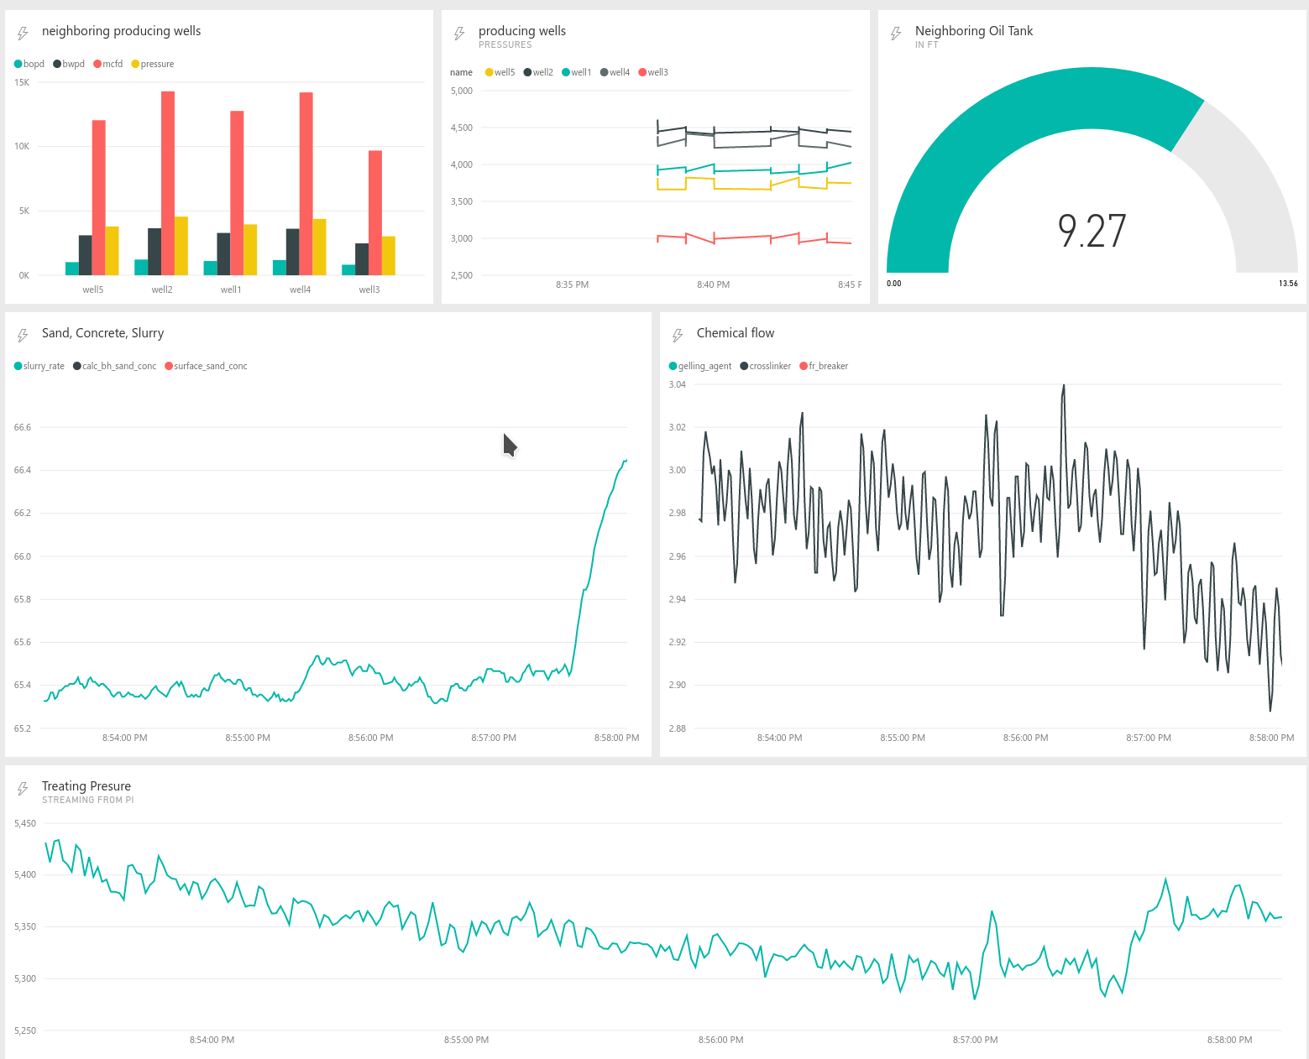
To

